Slide 1

Module 10: Advanced Ethical Hacking Techniques
(Exploit development concepts, social engineering awareness)

Slide 2
Introduction to Advanced Ethical Hacking

Slide 3
Advanced Ethical Hacking
Ethical hacking refers to authorized security testing performed to identify vulnerabilities before malicious attackers exploit them.
Advanced ethical hacking focuses on complex attack techniques used by professional attackers.
These techniques include:
  • exploit development
  • privilege escalation
  • social engineering attacks
  • web application attacks
  • post-exploitation activities
Ethical hackers study these techniques to strengthen security defenses.

Slide 4
Advanced Exploit Development

Slide 5
Exploit Development
Exploit development refers to the process of turning a vulnerability into a working attack.
An exploit is a method or code that takes advantage of a vulnerability in software or systems.
A vulnerability alone does not cause damage.
A vulnerability by itself does not cause damage.
An exploit is the code or method that uses the vulnerability to gain unauthorized access or control.
Damage occurs when an attacker uses an exploit to take advantage of it.

Slide 6
Exploit Development
Example: A program has a buffer overflow vulnerability.
An attacker writes an exploit to execute malicious code.
Example: A program contains a memory handling flaw.
An attacker uses this flaw to execute unauthorized commands.

Slide 7
Exploit Development Lifecycle
Attackers follow a structured process.
Step 1: Vulnerability Discovery: Security researchers identify weaknesses. Attackers search for weaknesses such as:
  • memory errors
  • software bugs
  • insecure configurations
  • logical design flaws
  • Buffer overflow
  • Memory corruption
  • Logic flaws
  • Misconfigurations

Slide 8
Exploit Development Lifecycle
Security researchers often discover these vulnerabilities first.
Step 2: Vulnerability Analysis
After finding a vulnerability, attackers analyze:
What input triggers the flaw
Which system component is affected
How the vulnerability behaves
What input triggers it
What system resources it affects

Slide 9
Exploit Development Lifecycle
Step 3: Exploit Creation
Attackers develop techniques to use the vulnerability.
The goal may be to:
  • Crash programs
  • Execute commands
  • Gain system access
  • crash systems
  • gain unauthorized access
  • execute malicious commands

Slide 10
Exploit Development Lifecycle
Step 4: Exploit Delivery
The exploit is delivered through:
  Malicious files
  Network packets/requests
  Web requests
  web application inputs

Slide 11
Exploit Development Lifecycle
Step 5: Post Exploitation
After access attackers may:
  • Escalate privileges
  • Move laterally
  • Extract data
Exploit development is studied to understand vulnerabilities and build stronger defenses.
Students are not expected to develop real exploits in this course.

Slide 12
Defensive Perspective
Organizations defend against exploits by:
• Applying security patches
• Using secure coding practices
• Performing penetration testing

Slide 13
Privilege Escalation
Privilege escalation occurs when a user gains higher access rights than originally permitted or higher access permissions than originally granted.
Example: A normal user gaining administrator access.

Slide 14
Types of Privilege Escalation
1. Vertical Privilege Escalation: Moving from lower privileges to higher privileges.
Example:
User → Administrator
This often occurs due to:
  • Misconfigured permissions
  • Software vulnerabilities
  • Weak system policies
  • system misconfigurations
  • unpatched vulnerabilities

Slide 15
Types of Privilege Escalation
2. Horizontal Privilege Escalation
Accessing another user's account with same privilege level.
Example: User A accessing data belonging to User B’s data.
Often caused by:
• Weak authentication
• Session management issues/flaws

Slide 16
Defensive Strategies
Organizations prevent privilege escalation by:
  • Strong access control policies
  • Regular patch management
  • Least privilege principle
  • Monitoring system logs

Slide 17
Social Engineering
Social engineering attacks exploit human psychology rather than technical vulnerabilities.
Attackers manipulate people to obtain sensitive information.
Humans are often considered the weakest link in security.
Why Social Engineering Works
Social engineering attacks exploit human psychology rather than technology.
Humans often trust:
  • Authority figures
  • Urgent requests
  • Familiar names
Attackers manipulate these behaviors.

Slide 18
Common Social Engineering Techniques
1. Phishing
Fake emails that trick users into:
• Revealing passwords
• Clicking malicious links
• Downloading malware
2. Pretexting
The attacker pretends to be someone trustworthy.
Example: An attacker pretending to be IT support requesting login credentials.

Slide 19
Common Social Engineering Techniques
3. Baiting
Attackers use attractive offers to trick victims.
Attackers leave infected devices.
Example: A USB drive labeled Confidential Data left in public places.
USB drives labeled "Salary Data".
Curious employees plug them in.

Slide 20
Common Social Engineering Techniques
4. Tailgating
An unauthorized person follows an authorized employee into a secure area.
Unauthorized person follows an employee into secure areas.
Example: Someone entering office by following an employee with access card.
Example: Entering an office building without an access card.

Slide 21
Common Social Engineering Techniques
Prevention Strategies
Organizations reduce social engineering risks through:
• employee awareness training
• email filtering systems
• strong identity verification procedures

Slide 22
Web Application Attack Awareness
Web applications are one of the most common attack targets.
Web applications are frequent targets of cyber attacks.
Ethical hackers study these attacks to help developers secure applications.

Slide 23
Web Application Attack Awareness
Common attack types.
SQL Injection
SQL injection occurs when attackers insert malicious database queries into application inputs.
Occurs when attackers insert malicious SQL commands into input fields.
Example vulnerable input: Login form.
If input validation is missing, attackers can manipulate database queries.
Example target: Login forms or search boxes.

Slide 24
Web Application Attack Awareness
Common attack types.
SQL Injection
Impact may include:
  • Data theft
  • Account access
  • Database manipulation
  • unauthorized database access
  • modification of records

Slide 25
Web Application Attack Awareness
Common attack types.
Cross-Site Scripting (XSS):
XSS occurs when attackers inject malicious scripts into web pages.
These scripts execute when other users view the page.
Attackers inject malicious scripts into web pages.
When other users load the page, the script executes.

Slide 26
Web Application Attack Awareness
Common attack types.
Cross-Site Scripting (XSS):
Impact:
  • Cookie theft
  • Session hijacking
  • Malware delivery
  • stealing user session cookies
  • redirecting users to malicious sites

Slide 27
Web Application Attack Awareness
Common attack types.
Cross-Site Request Forgery (CSRF)
CSRF tricks authenticated users into performing unintended actions.
Tricks a logged-in user into performing unintended actions.
Example: User clicks malicious link while logged into bank account.
The link performs unauthorized transaction.
Example: A malicious website triggers a bank transfer when a logged-in user visits the page.

Slide 28
Web Application Attack Awareness
Defensive Techniques:
Developers prevent these attacks using:
  • Input validation
  • Output encoding
  • Secure Authentication checks
  • Secure session management

Slide 29
Post-Exploitation Awareness
After attackers gain access to a system, they attempt to expand their control.
This stage is called post-exploitation.
They try to expand control across the system.

Slide 30
Activities During Post-Exploitation
Typical Post-Exploitation Activities
Data Discovery
Attackers search for sensitive information such as:
• financial records
• customer databases
• confidential documents
• Databases
• Password files

Slide 31
Activities During Post-Exploitation
Credential Harvesting
Attackers attempt to collect authentication information.
Example targets:
• Password hashes
• Stored browser credentials
• Stored authentication tokens
Lateral Movement
Attackers move from one compromised system to others in the network.
Attackers move from one machine to another.
Goal: Compromise the entire network.

Slide 32
Defensive Strategies
Organizations detect post-exploitation activities through:
System monitoring
Network traffic analysis
Network monitoring
Behavior analysis
Endpoint detection tools
Security Information & Event Management (SIEM)

Slide 33
Defense Mapping
Explain how each attack is defended.
Attack Type | Defense
Exploit attacks | Patch management
Privilege escalation | Access control
Social engineering | Security awareness training
Web attacks | Secure coding practices
Post exploitation | Monitoring & detection

Slide 34
Ethics & Legal Emphasis
Ethical hacking must follow strict legal and professional guidelines.
Ethical hacking is legal only when authorized.
Rules:
• Always obtain written permission
• Never attack systems without authorization
• Respect privacy and confidentiality
Always obtain authorization before testing
never access systems without permission
respect privacy and confidentiality
Ethical hackers help organizations improve security, not exploit weaknesses.

Slide 35
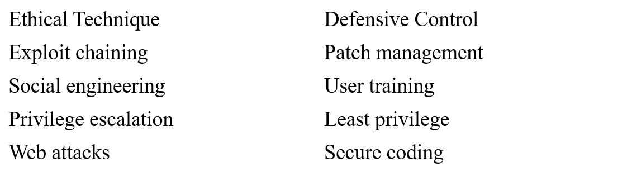
Defense Mapping

Slide 36
Thankyou

